Slide 1
DYNAMIC PROGRAMMING
GENERAL METHOD
CHAINED MATRIX MULTIPLICATION
ALL PAIRS SHORTEST PATH
OPTIMAL BINARY SEARCH TREE
0/1 KN APSACK PROBLEM
RELIABILTY DESIGN
TRAVELLING SALESMAN PROBLEM

Slide 2
Greedy Method Vs Dynamic Programming
The Greedy Method, Dynamic Programming techniques are used for obtaining optimal solution.
The Greedy Method is a straight forward approach for choosing the optimum choice or solution. It simply picks up the optimum solution without revising the previous solutions.
The Dynamic Programming, considers all the possible sequences in order to obtain the optimal solution.
It is guaranteed that the Dynamic Programming will generate optimal solution using principle of optimality but in case of greedy algorithm there is no such guarantee.

Slide 3
DYNAMIC PROGRAMMING
Divide and conquer is a top-down method.
When a problem is solved by divide and conquer, we immediately attack the complete instance, which we then divide into smaller and smaller sub-instances as the algorithm progresses.
Dynamic programming on the other hand is a bottom-up technique.
We usually start with the smallest and hence the simplest sub- instances.
By combining their solutions, we obtain the answers to sub-instances of increasing size, until finally we arrive at the solution of the original instances.
The essential difference between the greedy method and dynamic programming is that the greedy method only one decision sequence is ever generated.
In dynamic programming, many decision sequences may be generated. However, sequences containing sub-optimal sub-sequences can not be optimal and so will not be generated.

Slide 4
DYNAMIC PROGRAMMING
The idea of dynamic programming is thus quit simple: avoid calculating the same thing twice, usually by keeping a table of known result that fills up a sub instances are solved.
In dynamic programming the principle of optimality is used to reduce the decision sequences.
Principle of optimality:
An optimal sequence of decisions has the property that whatever the initial state and decisions are, the remaining decisions must constitute an optional decision sequence with regard to the state resulting from the first decision.

Slide 5
DYNAMIC PROGRAMMING
Sequence Of Decisions
Decide the x_{i} values in the order x₁, x₂, x₃, …, x_{n}.
OR
Decide the x_{i} values in the order x_{n}, x_{n-1}, x_{n-2}, …, x₁.
Thus the essential difference between the greedy method and dynamic programming is that in the greedy only one decision sequence is generated ever. In dynamic programming , many decision sequences may be generated.
However sequences containing suboptimal subsequences may not be optimal.

Slide 6
Ex. Shortest Path:
One way to find the shortest path from vertex i to j in a directed graph G is to decide which vertex should be the second vertex, which the third, which the fourth an vertex d so on., until vertex j is reached. An optimal solution is the one that results in a path of least length.
Here, Assume that i,i₁,i₂,…..,i_{k},j is the shortest path from i to j.
Starting with initial vertex i, a decision has been made to go to vertex i_{1.}
Following this decision, the problem state is defined by vertex i and we need to find a path from i₁ to j.
It is clear that the sequence i,i₁,i₂,…..,i_{k},j must constitute a shortest i₁ to j path.
If not let i₁, r₁, r₂, ….. , r_{q} , j be a shortest path then i₁, r₁, r₂, ….. , r_{q} , j is an i to j path shorter that the path i,i₁,i₂,…..,i_{k},j
^{n}
Although the total number of different decision sequences is exponential in the number of decisions (if there are d choices for each of the n decisions to be made then there are d^{n} possible decisions), dynamic programming algorithms often have a polynomial time complexity

Slide 7
Another important feature of the dynamic programming approach is that optimal solution to sub-problems are retained so as to avoid re-computing their values. (memorization)
The use of these tabulated values makes it natural to recast the recursive equation into an iterative algorithm. (tabulation)

Slide 8
Dynamic programming adapts tabulation method and Memorization.
Ex: finding n fibonacci elements.
0 if n =0
fib(n) = 1 if n = 1
fib(n-2) + fib(n-1) if n>0
fib(5)
fib(3) + fib(4)
fib(1) + fib(2) fib(2) + fib(3)
1 fib(0) + fib(1) fib(0) + fib(1) fib(0) + fib(1)
int fib( int n )
{
if ( n<=1 ) then
return n;
return fib(n-2) + fib(n-1);
}
For finding fib(5) it takes 15 calls by masters theorem the time complexity is calculated as O(2^{n})

Slide 9
To reduce the time complexity we introduce memoization concept
Memorization: Here the result of the recursion is stored so that when ever the same recursion is called we need not compute it again, instead the stored results can be used.
In the previous example of once fib(2) is computed then it should not be computed again, instead it should call the previous result. As Follows..
Consider an array call it memo
-1 | -1 | -1 | -1 | -1
0 1 2 3 4 5 6
Now for fib(1) we don’t have any value in array, that means it was not computed, so compute and store the value in the array .
Similarly do it with all the recursions.
Step1:
Step 2:
Step 3:
Step 4:
0 | 1 | 1 | 2 | -1
0 1 2 3 4 5
-1 | 1 | -1 | -1 | -1
0 1 2 3 4 5
Step 5:
0 | 1 | 1 | 2 | 3
0 1 2 3 4 5
0 | -1 | -1 | -1 | -1
Step 6:
0 1 2 3 4 5
0 | 1 | 1 | 2 | 3 | 5
0 1 2 3 4 5
0 | 1 | 1 | -1 | -1
0 1 2 3 4 5

Slide 10
Algorithm with the introduction of memo array:- (top down approach)
Tabulation method: (iterations, bottom up approach)
int fib(int n)
{
If n is in memo[ ] then
return memo[ n ]
else if n <= 2 then
f = 1;
else
f:= fib(n-2) + fib(n-1)
memo[ n ] := f;
return f;
}
fib(k) only recurs for the first time its called for all k
Iterative algorithm to find the nth element of Fibonacci series
int fib(intn)
{
if n<=1 then return n;
f[0] := 0; f[1] := 1;
for i:=2 to n do in step 1
f[i] := f[i-2] + f[i-1];
return f[n];
}

Slide 11
CHAIN MATRIX MULTIPLICATION
Given some matrices to multiply, determine the best order to multiply them so you minimize the number of single element multiplications.
i.e. Determine the way the matrices are parenthesized.
First off, it should be noted that matrix multiplication is associative, but not commutative. But since it is associative, we always have:
((AB)(CD)) = (A(B(CD))), or any other grouping as long as the matrices are in the same consecutive order.
BUT NOT: ((AB)(CD)) = ((BA)(DC))
The key in solving this problem is noticing the sub-problem optimality condition:

Slide 12
CHAIN MATRIX MULTIPLICATION
If a particular parenthesizing of the whole product is optimal, then any sub-parenthesization in that product is optimal as well.
If (A (B ((CD) (EF)) ) ) is optimal
Then (B ((CD) (EF)) ) is optimal as well
Assume that we are calculating ABCDEF and that the following parenthesization is optimal:
(A (B ((CD) (EF)) ) )
Then it is necessarily the case that
(B ((CD) (EF)) )
is the optimal parenthesization of BCDEF.
if we say ( ((BC) (DE)) F) was better, then it would also follow that
(A ( ((BC) (DE)) F) ) was better than (A (B ((CD) (EF)) ) ),
Which is contradicting its optimality!

Slide 13
CHAIN MATRIX MULTIPLICATION
Assume that we are calculating ABCDEF and that the following parenthesization is optimal:
(A (B ((CD) (EF)) ) )
Then it is necessarily the case that
(B ((CD) (EF)) )
is the optimal parenthesization of BCDEF.
if we say ( ((BC) (DE)) F) was better, then it would also follow that
(A ( ((BC) (DE)) F) ) was better than (A (B ((CD) (EF)) ) ),
Which is contradicting its optimality!

Slide 14
CHAIN MATRIX MULTIPLICATION
Thus, our goal is to:
Given a chain of matrices to multiply, determine the sequence of multiplication of matrices such that it incurs fewest number of element multiplications to compute the product.
Formal Definition of the problem:
Let A = A₀• A₁• ... A_{n-1}
Let N_{i,j} denote the minimal number of multiplications necessary to find the product:
A_{i}• A_{i+1}• ... A_{j}.
And let d_{i}xd_{i+1} denote the dimensions of matrix A_{i}.
We must attempt to determine the minimal number of multiplications necessary(N_{0,n-1}) to find A, assuming that we simply do each single matrix multiplication in the standard method.

Slide 15
CHAIN MATRIX MULTIPLICATION
Our final multiplication will ALWAYS be of the form
(A₀• A₁• ... A_{k}) • (A_{k+1}• A_{k+2}• ... A_{n-1})
In essence, there is exactly one value of k for which we should "split" our work into two separate cases so that we get an optimal result.
Here is a list of the cases to choose from:
(A₀) • (A₁• A_{k+2}• ... A_{n-1})
(A₀• A₁) • (A₂• A_{k+2}• ... A_{n-1})
(A₀• A₁•A₂) • (A₃• A_{k+2}• ... A_{n-1})
...
(A₀• A₁• ... A_{n-3}) • (A_{n-2} • A_{n-1})
(A₀• A₁• ... A_{n-2}) • (A_{n-1})
Basically, count the number of multiplications in each of these choices and pick the minimum. Also, the account for minimum number of multiplications in each of the two products
Another KEY Observation

Slide 16
CHAIN MATRIX MULTIPLICATION
Consider the case multiplying these 4 matrices: A: 2x4 B: 4x2 C: 2x3 D: 3x1
d₀ d₁ d₁ d₂ d₂ d₃ d₃ d₄
1. (A)(BCD) – The dimension of A is d₀xd₁ the resultant BCD dimension is d₁xd₄
so 2x4x4x1 = 8 multiplications, plus whatever work it will take to multiply (BCD).
2. (AB)(CD) – The resultant of (AB) is d₀xd₂ multiplied by resultant of (CD) is d₂xd₄,
so 2x2x2x1 = 4 multiplications, plus whatever work it will take to multiply (AB) and (CD).
3. (ABC)(D) – The resultant of (ABC) is d₀xd₃ multiplied by dimension of D is d₃xd₄
so 2x3x3x1 = 6 multiplications, plus whatever work it will take to multiply (ABC).

Slide 17
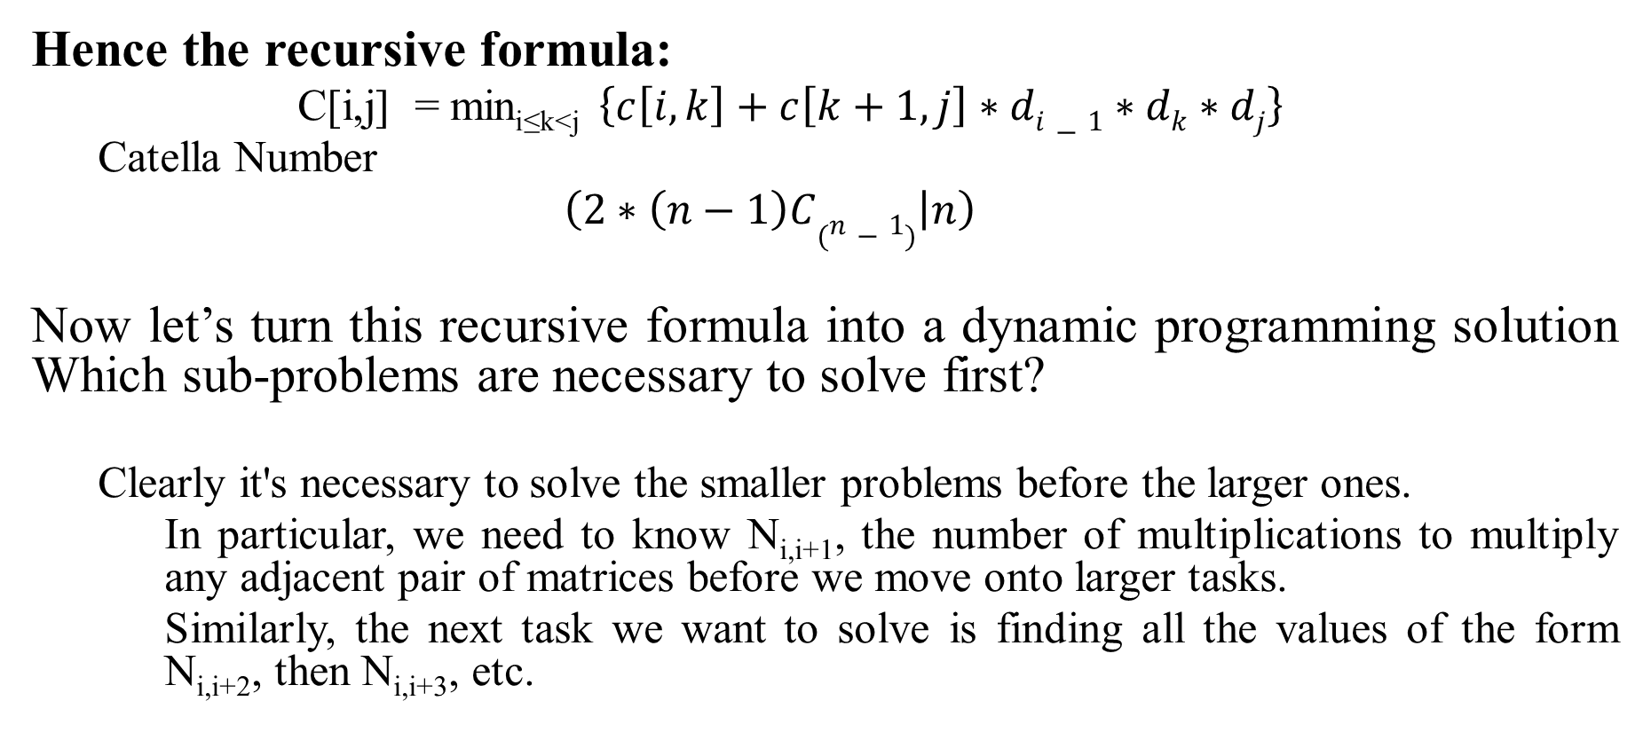
MATRIX CHAIN MULTIPLICATION
Hence the recursive formula:
C[i,j] = min_{i≤k<j} $\left\{c\left[i,k\right]+c\left[k+1,j\right]∗di−1∗dk∗dj\right\}$
Catella Number
$\left(2∗\left(n−1\right)C(n−1) | n\right)$
Now let’s turn this recursive formula into a dynamic programming solution Which sub-problems are necessary to solve first?
Clearly it's necessary to solve the smaller problems before the larger ones.
In particular, we need to know N_{i,i+1}, the number of multiplications to multiply any adjacent pair of matrices before we move onto larger tasks.
Similarly, the next task we want to solve is finding all the values of the form N_{i,i+2}, then N_{i,i+3}, etc.
17

Slide 18
MATRIX CHAIN MULTIPLICATION
Algorithm:
Step1: Initialize N[i][i] = 0, and all other entries in N to ∞.
Step2: for i=1 to n-1 do the following
2i) for j=0 to n-1-i do
2ii) for k=j to j+i-1
2iii) if (N[j][j+i-1] > N[j][k]+N[k+1][j+i-1]+d_{j}d_{k+1}d_{i+j})
N[j][j+i-1]= N[j][k]+N[k+1][j+i-1]+d_{j}d_{k+1}d_{i+j}
Basically, we’re checking different places to “split” our matrices by checking different values of k and seeing if they improve our current minimum value.
18

Slide 19
ALL-PAIRS SHORTEST PATH PROBLEM
Let G=( V,E ) be a directed graph consisting of n vertices.
Weight is associated with each edge.
The problem is to find a shortest path between every pair of nodes.
Idea of Floyd-Warshall Algorithm
Assume vertices are {1,2,……n}
Let A^{k}( i, j ) be the length of a shortest path from i to j with intermediate vertices numbered not higher than k where 0 ≤ k ≤ n, then
A⁰( i, j )=c( i, j ) (no intermediate vertices at all)
A ^{k}( i, j )=min { A^{k-1}( i, j ), A^{k-1}( i, k )+ A^{k-1}( k, j ) }
and A ^{n}( i, j ) is the length of a shortest path from i to j

Slide 20

ALL-PAIRS SHORTEST PATH PROBLEM
In summary, we need to find A ^{n} with A ⁰ =cost matrix .
General formula
$$Ak\left[i,j\right]=min⁡\{Ak−1\left[i,j\right],Ak_{1\left[i,k\right]}+Ak−1\left[k,j\right]\}$$

Slide 21
ALL-PAIRS SHORTEST PATH PROBLEM
Shortest Path using intermediate vertices
{ V_{1, . . .} V_{k -1} }
d ^{k-1}[i, k]
V_{k}
d ^{k-1}[k, j]
V_{i}
V_{j}
d ^{k-1}[i, j]

Slide 22
Algorithm
Algorithm AllPaths( c, A, n )
// c[1:n,1:n] cost matrix
// d[i,j] is the length of a shortest path from i to j
{
for i := 1 to n do
for j := 1 to n do
A [ i, j ] := c [ i, j ] ; // copy c into d
for k := 1 to n do
for i := 1 to n do
for j := 1 to n do
A [ i, j ] := min ( A [ i, j ] , A[ i, k ] + A [ k, j ] );
}
Time Complexity is O ( n ³ )

Slide 23
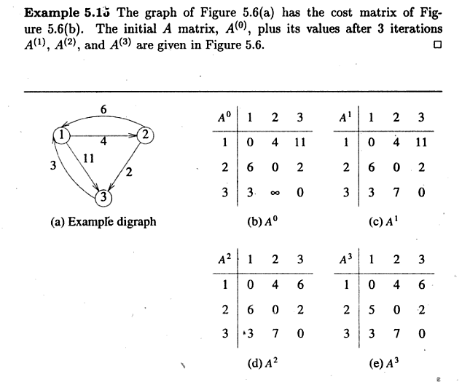
ALL-PAIRS SHORTEST PATH PROBLEM

Slide 24
Example:-
ALL-PAIRS SHORTEST PATH PROBLEM
1
3
v₁
v₂
9
5
1
2
3
v₅
3
2
v₄
v₃
4

Slide 25
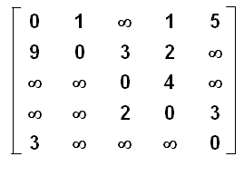
A⁰ =
A¹ =
A² =
A³ =
A⁴ =
A⁵ =

Slide 26
Optimal Binary Search Tree
(OBST)

Slide 27
Optimal Binary Search Tree(OBST)
What is a Binary Tree
Cost of searching
Probability of search/What is OBST
Dynamic programming approach
Deriving formula
Solving a Problem
Constructing an OBST

Slide 28
Optimal Binary Search Tree(OBST)
A binary search tree T is a binary tree, either it is empty
or each node in the tree contains an identifier and,
All identifiers in the left subtree of T are less than the identifier in the root node T.
All identifiers in the right subtree are greater than the identifier in the root node T.
The left and right subtree of T are also binary search trees.

Slide 29
Ex:- (a₁,a₂,a₃)
Here n = 3
The number of possible binary search trees= ^{2n}c_{n}/(n+1)
= (2*3C₃)/(3+1)
= 5
a₁
a₂
a₃

Slide 30
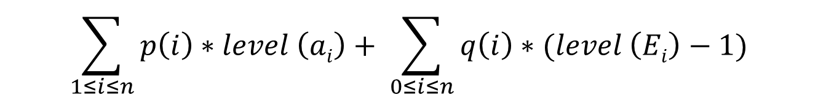
Identifiers : while, if, do
Internal node : successful search, p(i)
External node : unsuccessful search, q(i) {all the values should lie less than one }
a₁
a₂
E₃
a₃
E₂
E₀
E₁
The expected cost of a binary tree:
$$\sum_{1≤i≤n}{p\left(i\right)∗level \left(ai\right)+ \sum_{0≤i≤n}{q\left(i\right)∗(level \left(Ei\right)−1)}}$$

Slide 31
Optimal Binary Search Trees
Problem
Given sequence of identifiers (a₁,a₂ …., a_{n)} with a₁<a₂ <··· < a_{n.}
Let p(i) be the probability with which we search for a_{i}
Let q(i) be the probability with which we search for an identifier x such that a_{i} < x < a_{i+1} .
Want to build a binary search tree (BST) with minimum expected search cost.

Slide 32
The dynamic programming approach
Make a decision as which of the a_{i}’s should be assigned to the root node of the tree.
If we choose a_{k}, then it is clear that the internal nodes for a_{1,}a₂,……,a_{k-1} as well as the external nodes for the classes E₀, E₁,….,E_{k-1} will lie in the left subtree l of the root. The remaining nodes will be in the right subtree r.

Slide 33
cost( l)= ∑ p(i)*level(a_{i}) + ∑ q(i)*(level(E_{i})-1)
and
cost(r)=∑ p(i)*level(a_{i}) + ∑ q(i)*(level(E_{i})-1)
In both the cases the level is measured by considering the root of the respective sub tree to be at level 1.
we obtain the following as the expected cost of the above search tree.
p(k) + cost(l) + cost(r) + w(0,k-1) + w(k,n)
1≤i<k
0≤i<k
k<i≤n
k<i≤n

Slide 34
If we use c(i,j) to represent the cost of an optimal binary search tree t_{ij} containing a_{i+1},……,a_{j} and E_{i},…,E_{j}, then
cost(l) = c(0,k-1), and cost(r) = c(k,n).
For the tree to be optimal, we must choose k such that
p(k) + c(0,k-1) + c(k,n) + w(0,k-1) + w(k,n) is minimum.
Hence, for c(0,n) we obtain
c(0,n) = min c(0,k-1) + c(k, n) +p(k)+ w(0,k-1) + w(k,n)
We can generalize the above formula for any c(i,j) as shown below
c (i, j)= min c (i,k-1) + c (k,j) + p(k)+ w(i,k-1) + w(k,j)
0<k≤n
i<k≤j

Slide 35
c(i, j) = min cost(i,k-1) + cost(k,j) + w (i, j)
Therefore, c(0,n) can be solved by first computing all
c(i, j) such that j – i = 1, next we compute all c(i , j) such
that j – i = 2, then all c(i , j) with j – i = 3, and so on.
During this computation we record the root r(i, j) of each tree t _{ij}, then an optimal binary search tree can be constructed from these r(i, j).
r(i, j) is the value of k that minimizes the cost value.
Note:1. c(i,i) = 0, w(i, j) = q(i), and r(i, j) = 0 for all 0 ≤ i ≤ n
2. w(i, j) = p(j) + q(j) + w(i, j-1 )
i<k≤j

Slide 36
Ex 1: Let n=4, and ( a₁,a₂,a₃,a₄ ) Let p(1 : 4 ) = ( 3, 3, 1, 1) and q(0: 4) = ( 2, 3, 1,1,1 ).
p’s and q’s should be multiplied by a Positive Integer for convenience.

Slide 37
w₀₀=2 c₀₀=0 r₀₀=0 | w₁₁=3 c₁₁=0 r₁₁=0 | w₂₂=1 c₂₂=0 r₂₂=0 | w₃₃=1 c₃₃=0 r₃₃=0 | w₄₄=1 c₄₄=0 r₄₄=0
0
w₀₁=8 c₀₁=8 r₀₁=1 | w₁₂=7 c₁₂=7 r₁₂=2 | w₂₃=3 c₂₃=3 r₂₃=3 | w₃₄=3 c₃₄=3 r₃₄=4
1
j-i
w₀₂=12 c₀₂=19 r₀₂=1 | w₁₃=9 c₁₃=12 r₁₃=2 | w₂₄=5 c₂₄=8 r₂₄=3
2
w₀₃=14 c₀₃=25 r₀₃=2 | w₁₄=11 c₁₄=19 r₁₄=2
3
4
w₀₄=16 c₀₄=32 r₀₄=2
Computation of c(0,4), w(0,4), and r(0,4)

Slide 38
From the table we can see that c(0,4)=32 is the minimum cost of a binary search tree for ( a1, a2, a3, a4 ).
The root of tree t₀₄ is a_{2.}
The left subtree is t₀₁ and the right subtree t₂₄.
Tree t₀₁ has root a₁; its left subtree is t₀₀ and right subtree t₁₁.
Tree t₂₄ has root a₃; its left subtree is t₂₂ and right subtree t₃₄.
Thus we can construct OBST.

Slide 39
Ex 2: Let n=4, and ( a₁,a₂,a₃,a₄ ) = (count, float, int,while).
Let p(1 : 4 ) =( 1/20, 1/5, 1/10, 1/20) and
q(0: 4) = ( 1/5,1/10, 1/5,1/20,1/20 ).
Using the r(i, j)’s construct an optimal binary search tree.

Slide 40
OBST Algorithm
Algorithm OBST(p, q, n)
{
for i:= 0 to n-1 do
{ // initialize.
w[ i, i ] :=q[ i ]; r[ i, i ] :=0; c[ i, i ]=0;
// Optimal trees with one node.
w[ i, i+1 ]:= p[ i+1 ] + q[ i+1 ] + q[ i ] ;
c[ i, i+1 ]:= p[ i+1 ] + q[ i+1 ] + q[ i ] ;
r[ i, i+1 ]:= i + 1;
}
w[n, n] :=q[ n ]; r[ n, n ] :=0; c[ n, n ]=0;

Slide 41
// Find optimal trees with m nodes.
for m:= 2 to n do
{
for i := 0 to n – m do
{
j:= i + m ;
w[ i, j ]:= p[ j ] + q[ j ] + w[ i, j -1 ];
// Solve using Knuth’s result
x := Find( c, r, i, j );
c[ i, j ] := w[ i, j ] + c[ i, x -1 ] + c[ x, j ];
r[ i, j ] :=x;
}
}

Slide 42
Algorithm Find( c, r, i, j )
{
for k := r[ i, j -1 ] to r[ i+1, j ] do
{ min :=∞;
if ( c[ i, k -1 ] +c[ k, j ] < min ) then
{
min := c[ i, k-1 ] + c[ k, j ];
y:= k;
}
}
return y;
}

Slide 43
Time complexity of above procedure to evaluate the c’s and r’s
Above procedure requires to compute c(i, j) for
( j - i) = 1,2,…….,n .
When j – i = m, there are n-m+1 c( i, j )’s to compute.
The computation of each of these c( i, j )’s requires to find m quantities.
Hence, each such c(i, j) can be computed in time o(m).

Slide 44
The total time for all c(i,j)’s with j – i= m is
= m( n-m+1)
= mn-m²+m
=O(mn-m²)
Therefore, the total time to evaluate all the c(i, j)’s and r(i, j)’s is
∑ ( mn – m² ) = O(n³)
1 ≤ m ≤ n

Slide 45
We can reduce the time complexity by using the observation of D.E. Knuth
Observation:
The optimal k can be found by limiting the search to the range r( i, j – 1) ≤ k ≤ r( i+1, j )
In this case the computing time is O(n²).

Slide 46
0/1 Knapsack problem

Slide 47
0/1 Knapsack problem
Given: A set S of n objects, and a knapsack or bag
with each object i having
p_{i} - a positive profit
w_{i} - a positive weight
Goal: Choose items, either x_{i} = 0 or 1 , to maximize total profit but with weight at most m.
maximize ∑ p_{i}x _{i}
1 ≤ i ≤ n
subjected to ∑ w_{i}x_{i} ≤ m
1 ≤ i ≤ n
and x_{i} = 0 or 1 , 1 ≤ i ≤ n

Slide 48
0/1 Knapsack problem
Tabular Method
$$V\left[i,w\right]=\max{\{V\left[i−1,w\right], v\left[i−1,w−w\left[i\right]\right]+p\left[i\right]\}}$$
P | W | O | 0 | 1 | 2 | 3 | 4 | 5 | 6 | 7 | 8
0 | 0 | 0 | 0 | 0 | 0 | 0 | 0 | 0 | 0 | 0 | 0
1 | 2 | 1 | 0 | 0 | 1 | 1 | 1 | 1 | 1 | 1 | 1
2 | 3 | 2 | 0 | 0 | 1 | 2 | 2 | 3 | 3 | 3 | 3
5 | 4 | 3 | 0 | 0 | 1 | 2 | 5 | 5 | 6 | 7 | 7
6 | 5 | 4 | 0 | 0 | 1 | 2 | 5 | 6 | 6 | 7 | 8

Slide 49
0/1 Knapsack problem
Let f_{i}(y_{j}) be the values of optimal solution. Then S^{i} is a pair (p,w) where p = f (y_{j}) and w = y_{j}
Initially S⁰ = { (0,0) }. We can compute S^{i+1} from S^{i}. The Computations of S^{i} are sequence of decisions made for obtaining optimal solution.
2. Let x_{n} be the optimal sequence. Then there are two instances {x_{n}} and {x_{n-1},…..,x₁ }. So from {x_{n-1},…..,x₁} will choose optimal sequence with respect to x_{n}.

Slide 50
0/1 Knapsack problem
3. The formulas that are used while solving 0/1 knapsack problem.
Let f_{n}(m) be the value of an optimal solution,
then
f_{n}(m)= max { f_{n-1}(m), f_{n-1}( m - w_{n}) + p_{n} }
General formula
f_{i}(y)= max { f_{i-1}(y), f_{i-1}( y - w_{i}) + p_{i} }

Slide 51
Initially S⁰ = {(0,0)}
S₁^{i} ={ ( P,W) / (P- p_{i+1},W- w_{i+1}) ϵ S^{i} }
S^{i+1} can be computed by merging from S^{i} and S₁^{i}
Purging or dominance rule: if S^{i+1} contains two pairs (p_{j},w_{j} ) and (p_{k},w_{k} ) with the property that p_{j} ≤ p_{k} and w _{j} ≥ w _{k} then the pair (p_{j},w_{j} ) can be discarded.
When generating S ^{i}, we can also purge all pairs ( p, w ) with w > m as these pairs determine the value of f _{n} (x) only for x > m.
The optimal solution f _{n} (m) is given by the highest profit pair.

Slide 52
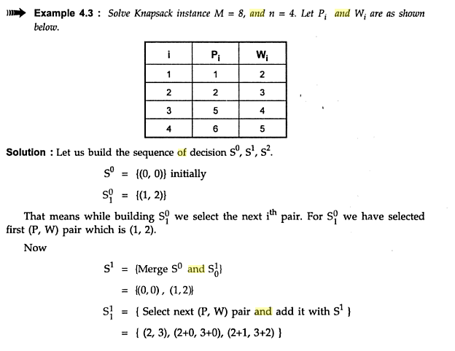

Slide 53
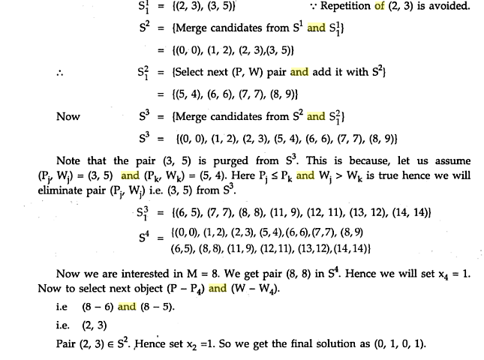

Slide 54
Example 1: Consider the knapsack instance n = 3,
(w₁,w₂,w₃) = (2,3,4), (p₁,p₂,p₃) = (1,2,5), and m = 6.
Initially
S⁰ = {(0,0)}
Include 1st object
S₁⁰ ={ ( 0+1,0+2) }= { (1,2) }
Next Stage can be obtained S⁰⁺¹ (S¹ )can be computed by merging from S⁰ and S₁⁰
S¹ ={(0,0)(1,2)}
Include 2nd object
S₁¹ ={ ( 0+2,0+3) (1+2, 2+3) }= { (2,3) (3,5) }
Next Stage can be obtained S¹⁺¹ (S² )can be computed by merging from S¹ and S₁¹
S² ={(0,0)(1,2)(2,3)(3,5)}
Include 3rd object
S₁² ={ ( 0+5,0+4) (1+5, 2+4)(2+5,3+4) (3+5,5+4) }
= {(5,4)(6,6)(7,7)(8,9)}

Slide 55
Next Stage can be obtained S²⁺¹ (S³ )can be computed by merging from S² and S₁²
S³ ={(0,0)(1,2)(2,3)(3,5) (5,4)(6,6)(7,7)(8,9)}
Apply Purging rule
Pairs(3,5) (7,7)(8,9) will be discarded
Therefore ,
S³ ={(0,0)(1,2)(2,3)(5,4)(6,6)}
X=(1,0,1)

Slide 56
Knapsack Algorithm
Algorithm DKP(p,w,n,m)
{
S⁰ := {(0,0)};
for i := 1 to n-1 do
{
S^{i-1} ={(P,W)|(P-p_{i} ,W-w_{i} ) ϵ S^{i-1} and W <= m);
S^{i} = MergePurge(S^{i-1} , S₁^{i-1});
}

Slide 57
(PX,WX) = last pair in S^{n-1} ;
(PY,WY)=(P¹+ p_{n} ,W¹+w_{n} ) where W¹ is the largest W in any pair in S^{n-1} such that W+ w_{n} <= m;
// Trace back for x_{n} ,x_{n-1},…..,x_{1.}
if (PX > PY) then x_{n} = 0;
else x_{n}=1;
TraceBackFor(x_{n-1},…..,x₁);
}

Slide 58
TIME COMPLEXITY OF THE APPROACH
It should be noted that the above function computes the same sub-problems again and again. See the following recursion tree, K(1, 1) is being evaluated twice. The time complexity of this naive recursive solution is exponential (2^n).

Slide 59
RELIABILTY DESIGN

Slide 60
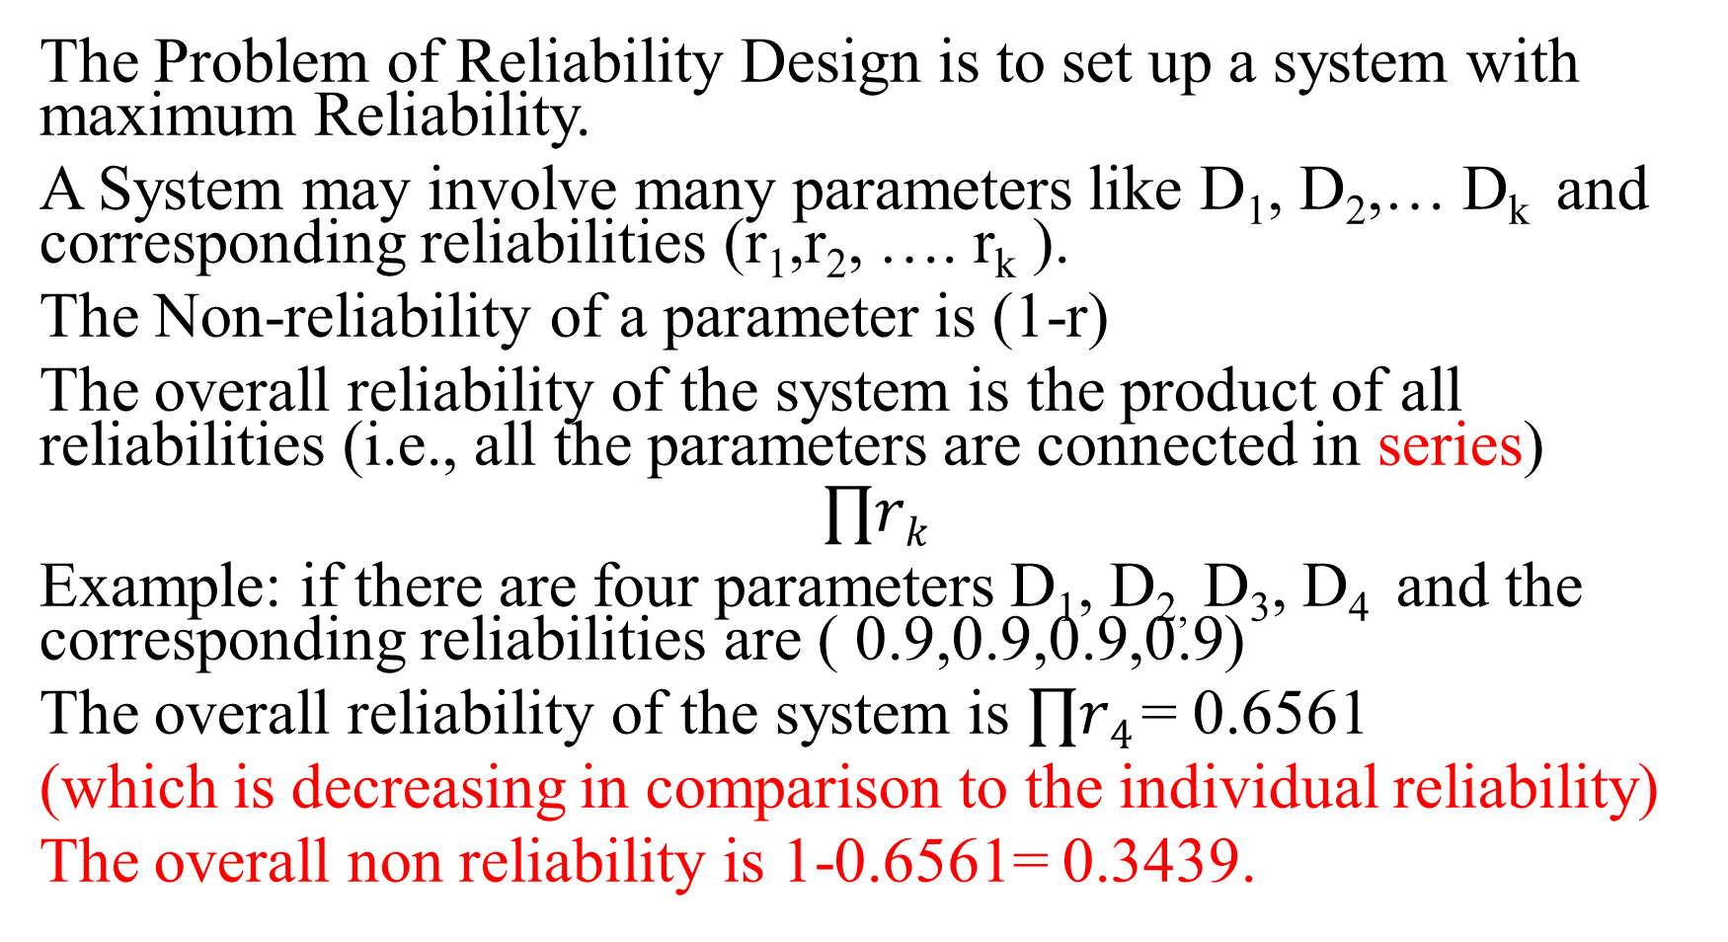
The Problem of Reliability Design is to set up a system with maximum Reliability.
A System may involve many parameters like D₁, D₂,… D_{k} and corresponding reliabilities (r₁,r₂, …. r_{k} ).
The Non-reliability of a parameter is (1-r)
The overall reliability of the system is the product of all reliabilities (i.e., all the parameters are connected in series)
$$∏rk$$
Example: if there are four parameters D₁, D_{2,} D₃, D₄ and the corresponding reliabilities are ( 0.9,0.9,0.9,0.9)
The overall reliability of the system is $∏r4$= 0.6561
(which is decreasing in comparison to the individual reliability)
The overall non reliability is 1-0.6561= 0.3439.

Slide 61
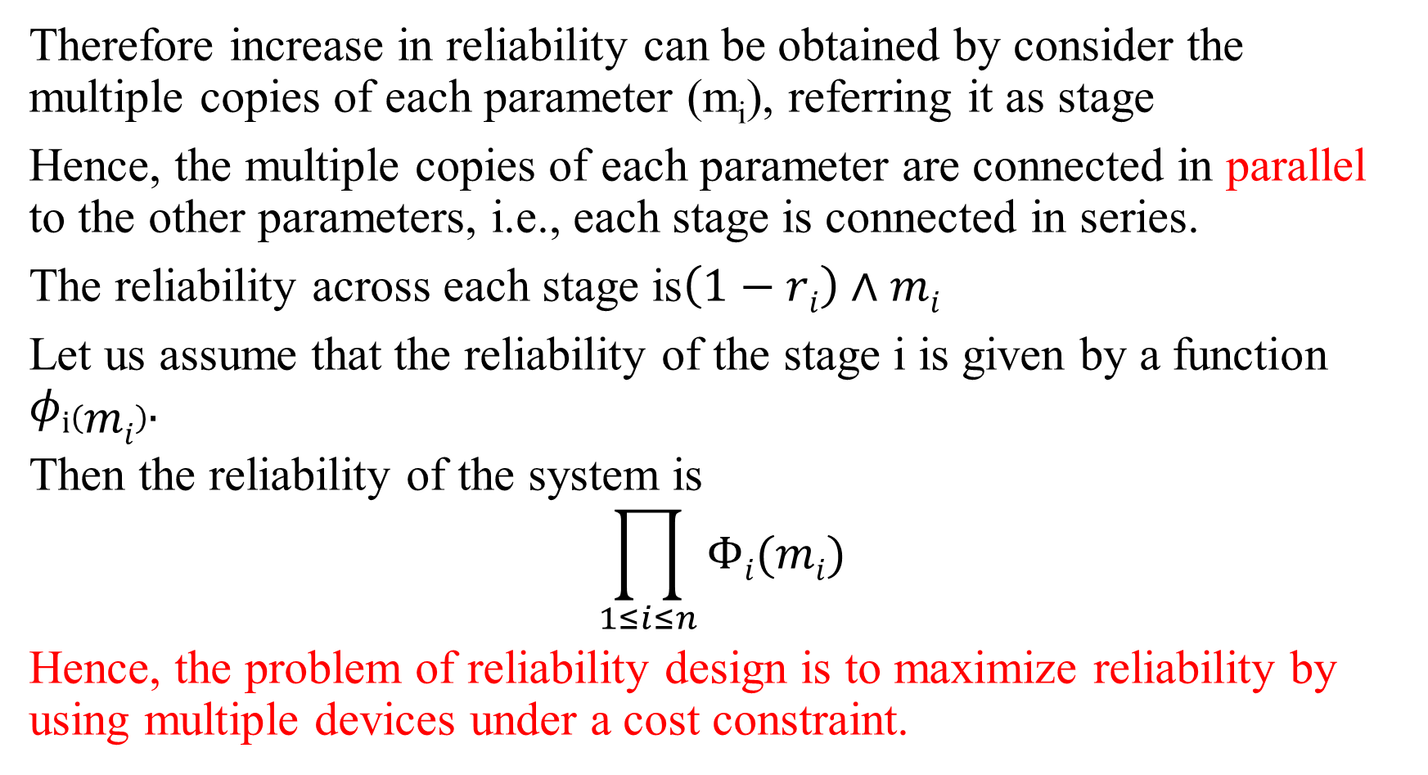
Therefore increase in reliability can be obtained by consider the multiple copies of each parameter (m_{i}), referring it as stage
Hence, the multiple copies of each parameter are connected in parallel to the other parameters, i.e., each stage is connected in series.
The reliability across each stage is$\left(1−ri\right)∧mi$
Let us assume that the reliability of the stage i is given by a function $φi\left(mi\right).$
Then the reliability of the system is
$$\prod_{1≤i≤n}{Φi(mi)}$$
Hence, the problem of reliability design is to maximize reliability by using multiple devices under a cost constraint.

Slide 62

Let C be the cost constraint i.e., maximum cost of the system
Let C_{i} be the cost of each unit of parameter referred as i,
The to consider the number of multiple copies of each parameter for each stage can be computed and referred as upper bound with following equation:
$$\left\lfloor (c−Σc)/ci\right\rfloor +1$$

Slide 63
Example: Let us consider the following table
Total cost is 105
From the given problem c=105,
c₁=30,r₁=0.9 for corresponding D₁;
c₂=15, r₂=0.8 for D₂;
c₃=0.5,r₃=20 for D₃.
Device (D) | Cost (c) | Reliability(r) | Upper Bound (u)
D₁ | 30 | 0.9
D₂ | 15 | 0.8
D₃ | 20 | 0.5

Slide 64

To compute the No. of Multiple copies denoted by the upper bound function u is for each device is
u_{i}=$\left\lfloor (c−Σc)/ci\right\rfloor +1$
$Σc=65$;
u₁= $\left\lfloor (105−65)/30\right\rfloor +1$ = 2
Similarly u₂=3; u₃=3
Device (D) | Cost (c) | Reliability (r) | Upper bound (u)
D₁ | 30 | 0.9 | 2
D₂ | 15 | 0.8 | 3
D₃ | 20 | 0.5 | 3

Slide 65
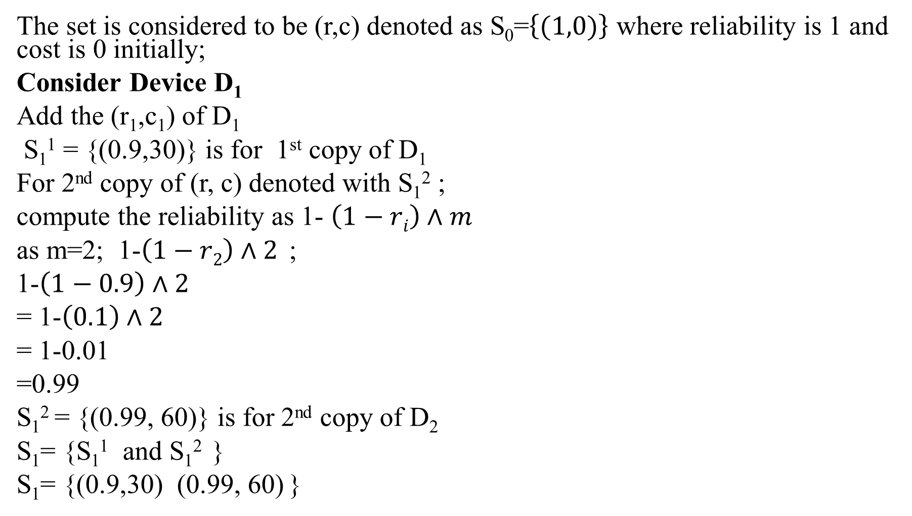
The set is considered to be (r,c) denoted as S₀=$\left\{(1,0)\right\}$ where reliability is 1 and cost is 0 initially;
Consider Device D₁
Add the (r₁,c₁) of D₁
S₁¹ = {(0.9,30)} is for 1st copy of D₁
For 2nd copy of (r, c) denoted with S₁² ;
compute the reliability as 1- $\left(1−ri\right)∧m$
as m=2; 1-$\left(1−r2\right)∧2$ ;
1-$\left(1−0.9\right)∧2$
= 1-$\left(0.1\right)∧2$
= 1-0.01
=0.99
S₁² = {(0.99, 60)} is for 2nd copy of D₂
S₁= {S₁¹ and S₁² }
S₁= {(0.9,30) (0.99, 60) }

Slide 66
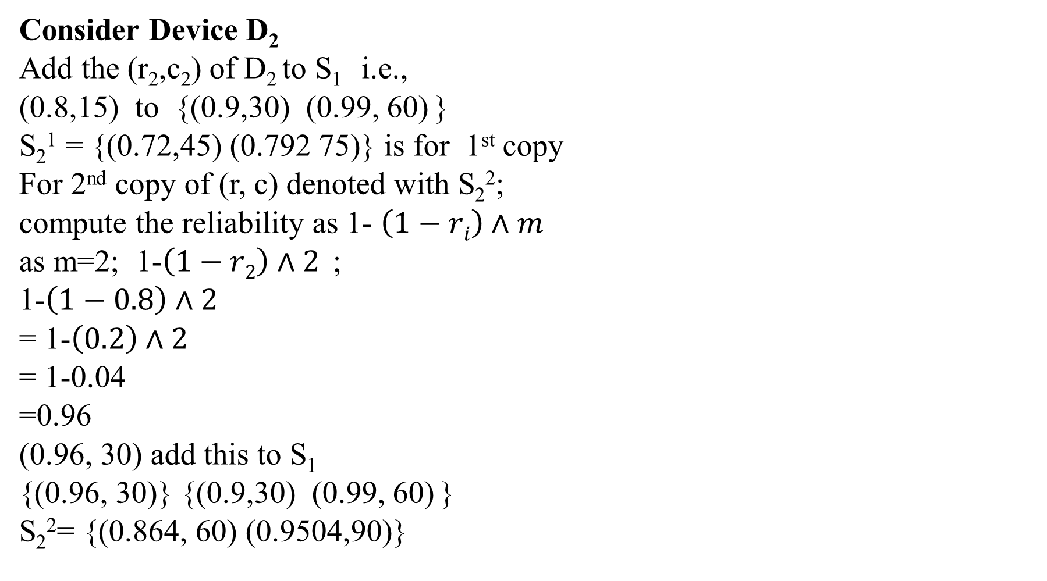
Consider Device D₂
Add the (r₂,c₂) of D₂ to S₁ i.e.,
(0.8,15) to {(0.9,30) (0.99, 60) }
S₂¹ = {(0.72,45) (0.792 75)} is for 1st copy
For 2nd copy of (r, c) denoted with S₂²;
compute the reliability as 1- $\left(1−ri\right)∧m$
as m=2; 1-$\left(1−r2\right)∧2$ ;
1-$\left(1−0.8\right)∧2$
= 1-$\left(0.2\right)∧2$
= 1-0.04
=0.96
(0.96, 30) add this to S₁
{(0.96, 30)} {(0.9,30) (0.99, 60) }
S₂²= {(0.864, 60) (0.9504,90)}

Slide 67
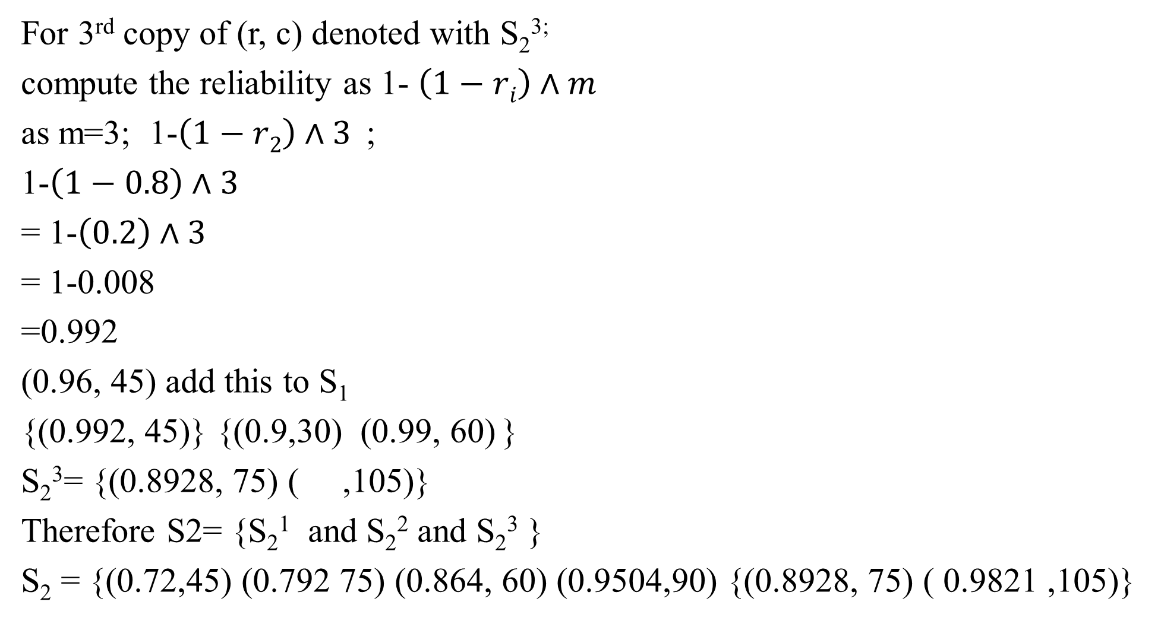
For 3rd copy of (r, c) denoted with S₂^{3;}
compute the reliability as 1- $\left(1−ri\right)∧m$
as m=3; 1-$\left(1−r2\right)∧3$ ;
1-$\left(1−0.8\right)∧3$
= 1-$\left(0.2\right)∧3$
= 1-0.008
=0.992
(0.96, 45) add this to S₁
{(0.992, 45)} {(0.9,30) (0.99, 60) }
S₂³= {(0.8928, 75) ( ,105)}
Therefore S2= {S₂¹ and S₂² and S₂³ }
S₂ = {(0.72,45) (0.792 75) (0.864, 60) (0.9504,90) {(0.8928, 75) ( 0.9821 ,105)}

Slide 68
S₂ = {(0.72,45) (0.792 75) (0.864, 60) (0.9504,90) {(0.8928, 75) ( 0.9821,105)}
Apply Dominance rule and weight assignment to discard the elements of S₂
S₂ = {(0.72,45) (0.792 75) (0.864, 60) (0.9504,90) (0.8928, 75) ( 0.9821,105)}
Therefore S₂ = {(0.72,45) (0.864 60) (0.8928, 75)
Consider Device D₃
Add the (r₃,c₃) of D₃ to S₂ i.e., (0.5,20)
Then S₃¹ = {(0,36,45) (0.432,80) (0.4464,95)}
Compute reliability for 2nd copy of S₃ then
S₃² = {(0.54,85) (0,648,100) ( ,115)}
Compute reliability for 3rd copy of S₃ then
S₃³= {(0.63,105) ( , 120) ( ,135)}
Therefore S₃ = {(0,36,45) (0.432,80) (0.4464,95) (0.54,85) (0,648,100) ( ,115)
(0.63,105) ( , 120) ( ,135)}

Slide 69
Apply Dominance rule and weight assignment to discard the elements of S₃
S₃ = {(0,36,45) (0.432,80) (0.4464,95) (0.54,85) (0,648,100) ( ,115)
(0.63,105) ( , 120) ( ,135)}
Therefore
S₃ = {(0,36,45) (0.432,80) (0.54,85) (0.648,100)}
Hence the Maximum reliability is 0.648 with cost of 100
How to compute the number of copies when reliability is maximum
The Maximum reliability is achieved at S₃² which determines the 2nd copy of device D₃hence for Device D₃ consider it 2 copies.

Slide 70
S₁¹ = {(0.9,30)} is for 1st copy of D₁
S₁² = {(0.99, 60)} is for 2nd copy of D₁
S₁= {(0.9,30) (0.99, 60) }
S₂¹ = {(0.72,45) (0.792 75)} is for 1st copy of D₂
S₂²= {(0.864, 60) (0.9504,90)} is for 2nd copy of D₂
S₂³= {(0.8928, 75) ( ,105)} is for 3rd copy of D₂
S₂ = {(0.72,45) (0.864 60) (0.8928, 75)
S₃¹ = {(0,36,45) (0.432,80) (0.4464,95)} is for 1st copy of D₃
S₃² = {(0.54,85) (0,648,100) ( ,115)} is for 2nd copy of D₃
S₃³= {(0.63,105) ( , 120) ( ,135)} is for 3rd copy of D₃
S₃ = {(0,36,45) (0.432,80) (0.54,85) (0.648,100)}

Slide 71
TRAVELLING SALESMAN PROBLEM

Slide 72
4.3 The Traveling Salesman problem
Problem: Let G = (V,E) be a directed graph with edge costs C_{ij}. The variable C_{ij} is defined such that C_{ij} > 0 for all i and j and C_{ij} = ∞ if (i,j) ∉ E. Let |V| = n and assume n > 1.
A tour of G is a directed simple cycle that includes every vertex in V. The cost of a tour is the sum of the cost of the edges on the tour.
The traveling sales person problem is to find a tour of minimum cost.
Applications of TSP:
Postal van to pickup mail from boxes located at n different cities.
Robot arm to tighten the nuts of some piece of machinery on an assembly line.

Slide 73
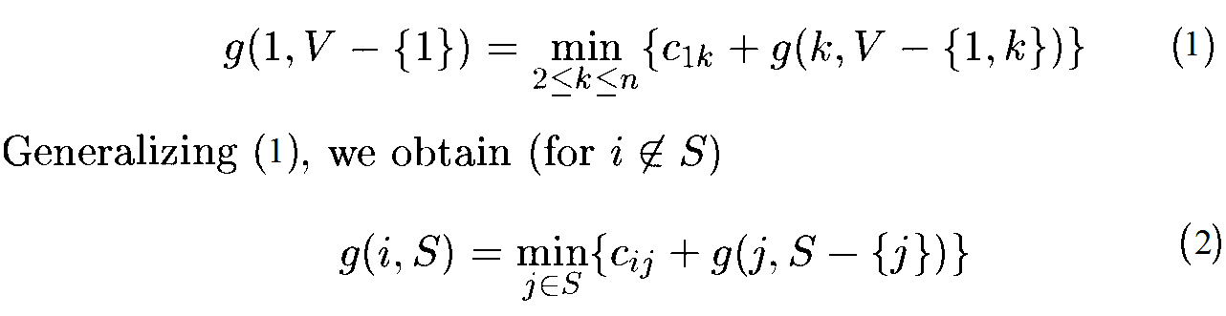
Every tour consists of an edge (1,k) for some k ∈ V - {1} and a path from vertex k to vertex 1.
The path from vertex k to vertex 1 goes through each vertex in V - {1, k} exactly once.
It is easy to see that if the tour is optimal, then the path from k to 1 must be a shortest k to 1 path going through all vertices in V - {1,k}. Hence, the principle of optimality holds.
Let g(i,S) be the length of a shortest path starting at vertex i, going through all vertices in S, and terminating at vertex i. The function g(1, V - {1}) is the length of an optimal sales person tour. From the principal of optimality it follows that

Slide 74
Equation (1) can be solved for g(1, V - {1}) if we know g(k, V - {1, k}) for all choices of k. The g values can be obtained by using eq^{n}(2).
Clearly, g(i, Ø) = c_{i1,} 1 ≤ i ≤ n.
Hence, we can use eq^{n}(2) to obtain g(i,S) for all S of size 1. Then we can obtain g(i,S) for S with |S|= 2, and so on. When |S| < n -1, the values of i and S for which g(i,S) is needed are such that i ≠ 1, 1 ∈ S, and i ∉ S.

Slide 75
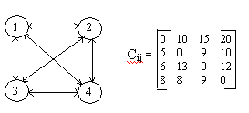
Example: Consider the directed graph of Figure (a). The edge lengths are given by matrix C of Figure (b).
Figure (a) Figure (b)

Slide 76
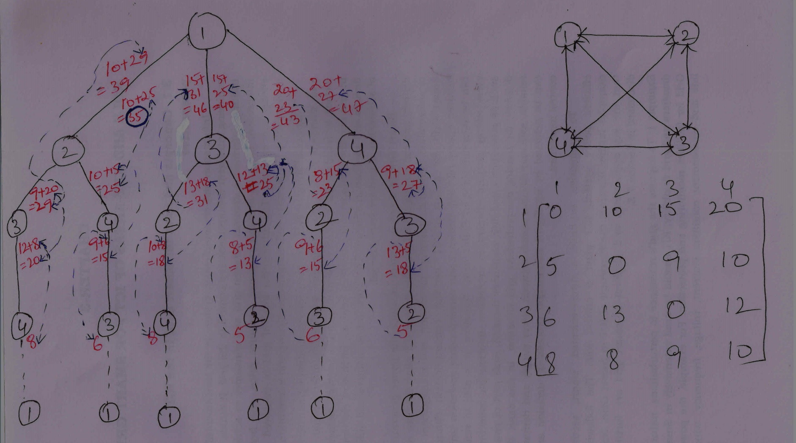

Slide 77
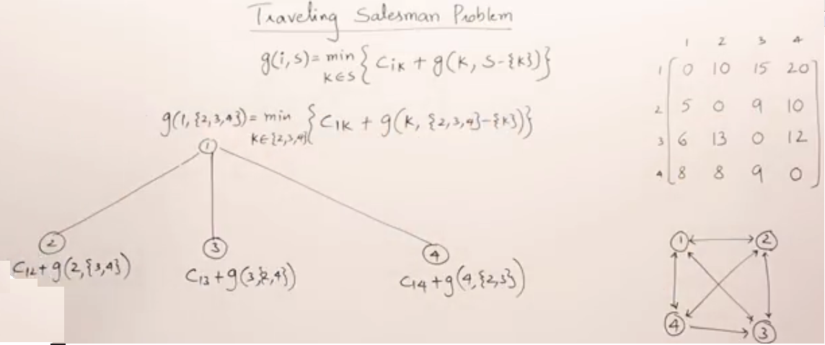

Slide 78
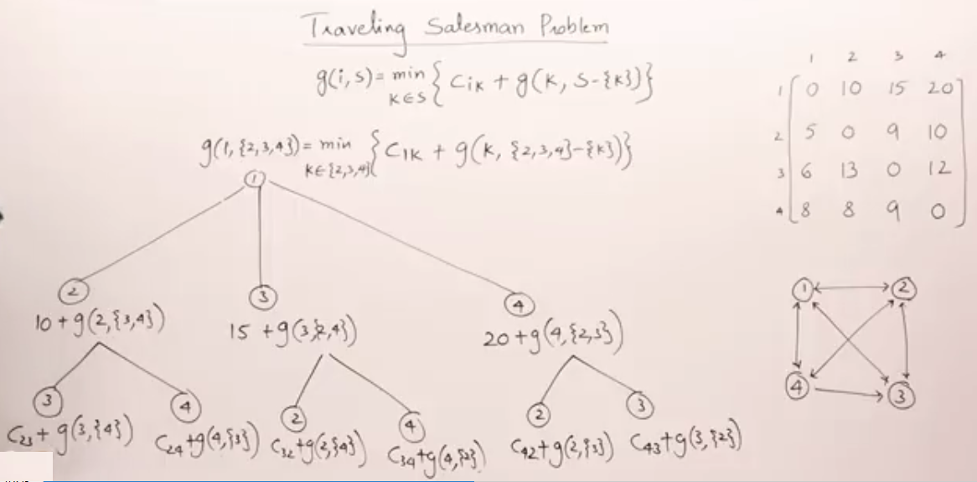

Slide 79
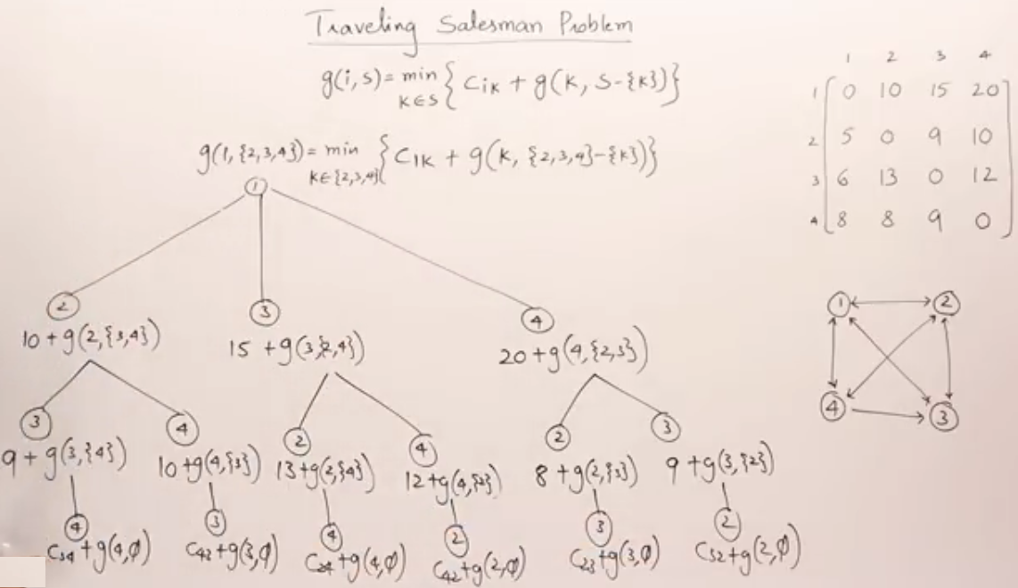

Slide 80
g(2, φ) = C₂₁ = 5
g(3, φ) = C₃₁ = 6
g(4, φ) = C₄₁ = 8
g(2, {3}) = C₂₃ + g(3, φ) = 15
g(2, {4}) = C₂₄ + g(4, φ) = 18
g(3, {2}) = C₃₂ + g(2, φ) = 18
g(3, {4}) = C₃₄ + g(4, φ) = 20
g(4, {2}) = C₄₂ + g(2, φ) = 13
g(4, {3}) = C₄₃ + g(3, φ) = 15

Slide 81
g(2, {3,4}) = min{C₂₃ + g(3, {4}) , C₂₄ + g(4, {3}) }
min{9 + 20 , 10 + 15} = 25 4 3
g(3, {2,4}) = min{C₃₂ + g(2, {4}) , C₃₄ + g(4, {2}) }
min{13 + 18 , 12 + 13} = 25
g(4, {2,3}) = min{C₄₂ + g(2, {3}) , C₄₃ + g(3, {2}) }
min{8 + 15, 9 + 18} = 23 2 4
g(1, {2,3,4}) = min{C₁₂ + g(2, {3,4}) , C₁₃ + g(3, {2,4}) , C₁₄ + g(4, {2,3}) }
= min{35, 40, 43} = 35 1 2
1 2 4 3 1

Slide 82
An optimal tour of the graph of Figure above has length 35.
A tour of this length can be constructed if we retain with each g(i, S) the value of j that minimizes the right-hand side of (2).
Let J(i, S) represent the value of j which is the value of g(i, S) that minimizes the right hand side of equ^{n} (2). Then J(1, {2,3,4}) =2, which infers that the tour starts from 1 goes to 2.
Since J(2,{3,4}) = 4, we know that from 2 it goes to 4. J(4, {3}) = 3. Hence the next vertex is 3. Then we have the optimal sequence as 1,2,4,3,1.

Slide 83
Analysis:
Time complexity : ⊖ (n²2^{n})
Space complexity: O(n2^{n})

